Slide 1
FRB Update
William Huang
(8/12/2020)

Slide 2
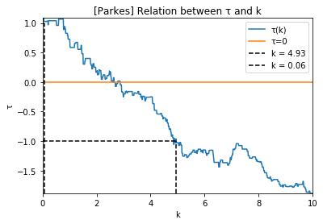
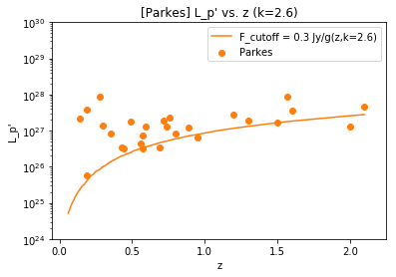
Mistake in Kendall Tau + New Flux Limit
I found that I had made a mistake in my program for kendall tau. Additionally, since the k-value as you mentioned as pretty high, I increased the flux cutoff to 0.3 Jy. The tau vs. k graph and the tau = 0 (k=2.6 now) graph are shown.

Slide 3
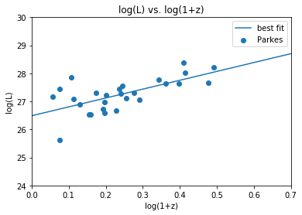
Quick log(L) vs. log(1+z) fit
Previously, I had done a log L- logLlim fit but not a log L to log(1+z) fit. In this case, the best fit line turned out to be 3.165x + 26.487. Both our old and new k values are below 3.165, which is good.

Slide 4
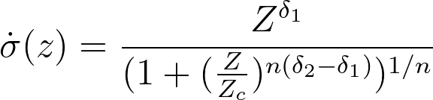
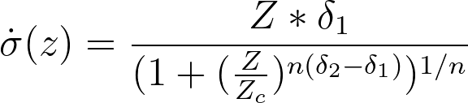
Question about fitted figures
I was trying to plot function #1 with the red corrected parameters, but the result was the figure on the right on the next page, specifically the green line. I also tried using the formula #2, because I wasn’t sure which formula was being used, but that resulted in the thick blue line. What is the correct form of the function?
1)
2)

Slide 5
